Slide 1
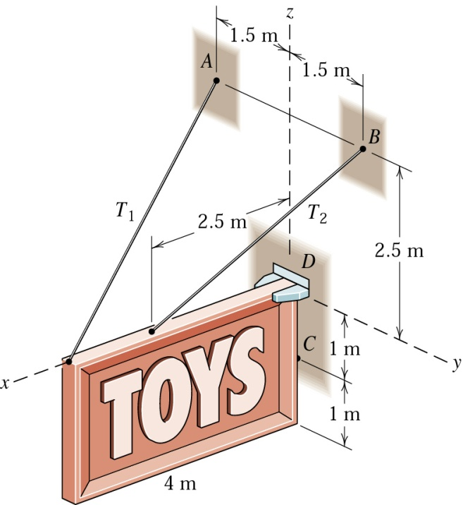

2103-213 Engineering Mechanics I
D
O
K
C
A
B

Slide 2
Manner Guideline in this Lecture Course
Be reasonable and act politely.
Turn off your mobile phone. If you have urgent calls
to make or answer, kindly leave the room.
No food. Only water and candy are allowed.
No noisy chat and all other activities that can distract
the lecture should be avoided.
Do not disturb your classmates.
Dress properly.

Slide 3
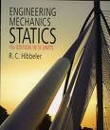
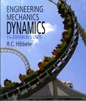
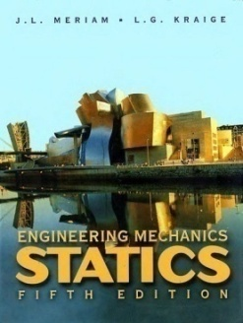

Textbook
“Engineering Mechanics STATICS”
R.C. Hibbeler, Engineering Mechanics
“Engineering Mechanics DYNAMICS”
R.C. Hibbeler, Engineering Mechanics
“Engineering Mechanics, STATICS”
Meriam and Kraige
“Engineering Mechanics, DYNAMICS”
Meriam and Kraige

Slide 4

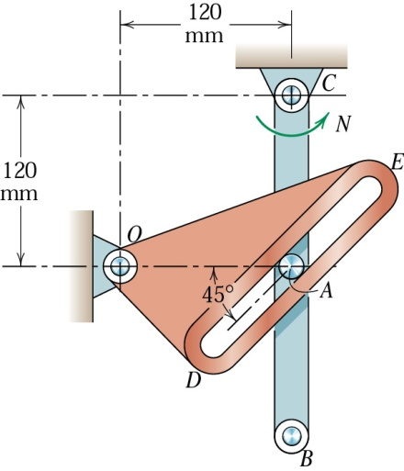
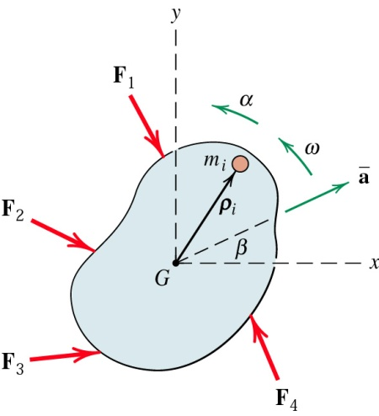
Mechanics ?
  A branch of physical science which deals with ( the states of rest or motion of ) bodies under action of forces
Mechanics
Statics:
Equilibrium of bodies
(no accelerated motion)
under action of Forces
Statics
Dynamics
-Equilibrium
-Selected Topics
Dynamics: Motion of bodies
Kinematics
Kinetics
-Particles
-Rigid Bodies
-Particles
- Rigid Bodies

Slide 5
Mechanics #2
Basic Concepts
Statics
Dynamics
Mech of Materials
Fluid Mechanics
Vibration
Fracture Mechanics
Etc.
Structures
Automotives
Robotics
Spacecrafts
MEMs
Etc.
Mechanics

Slide 6
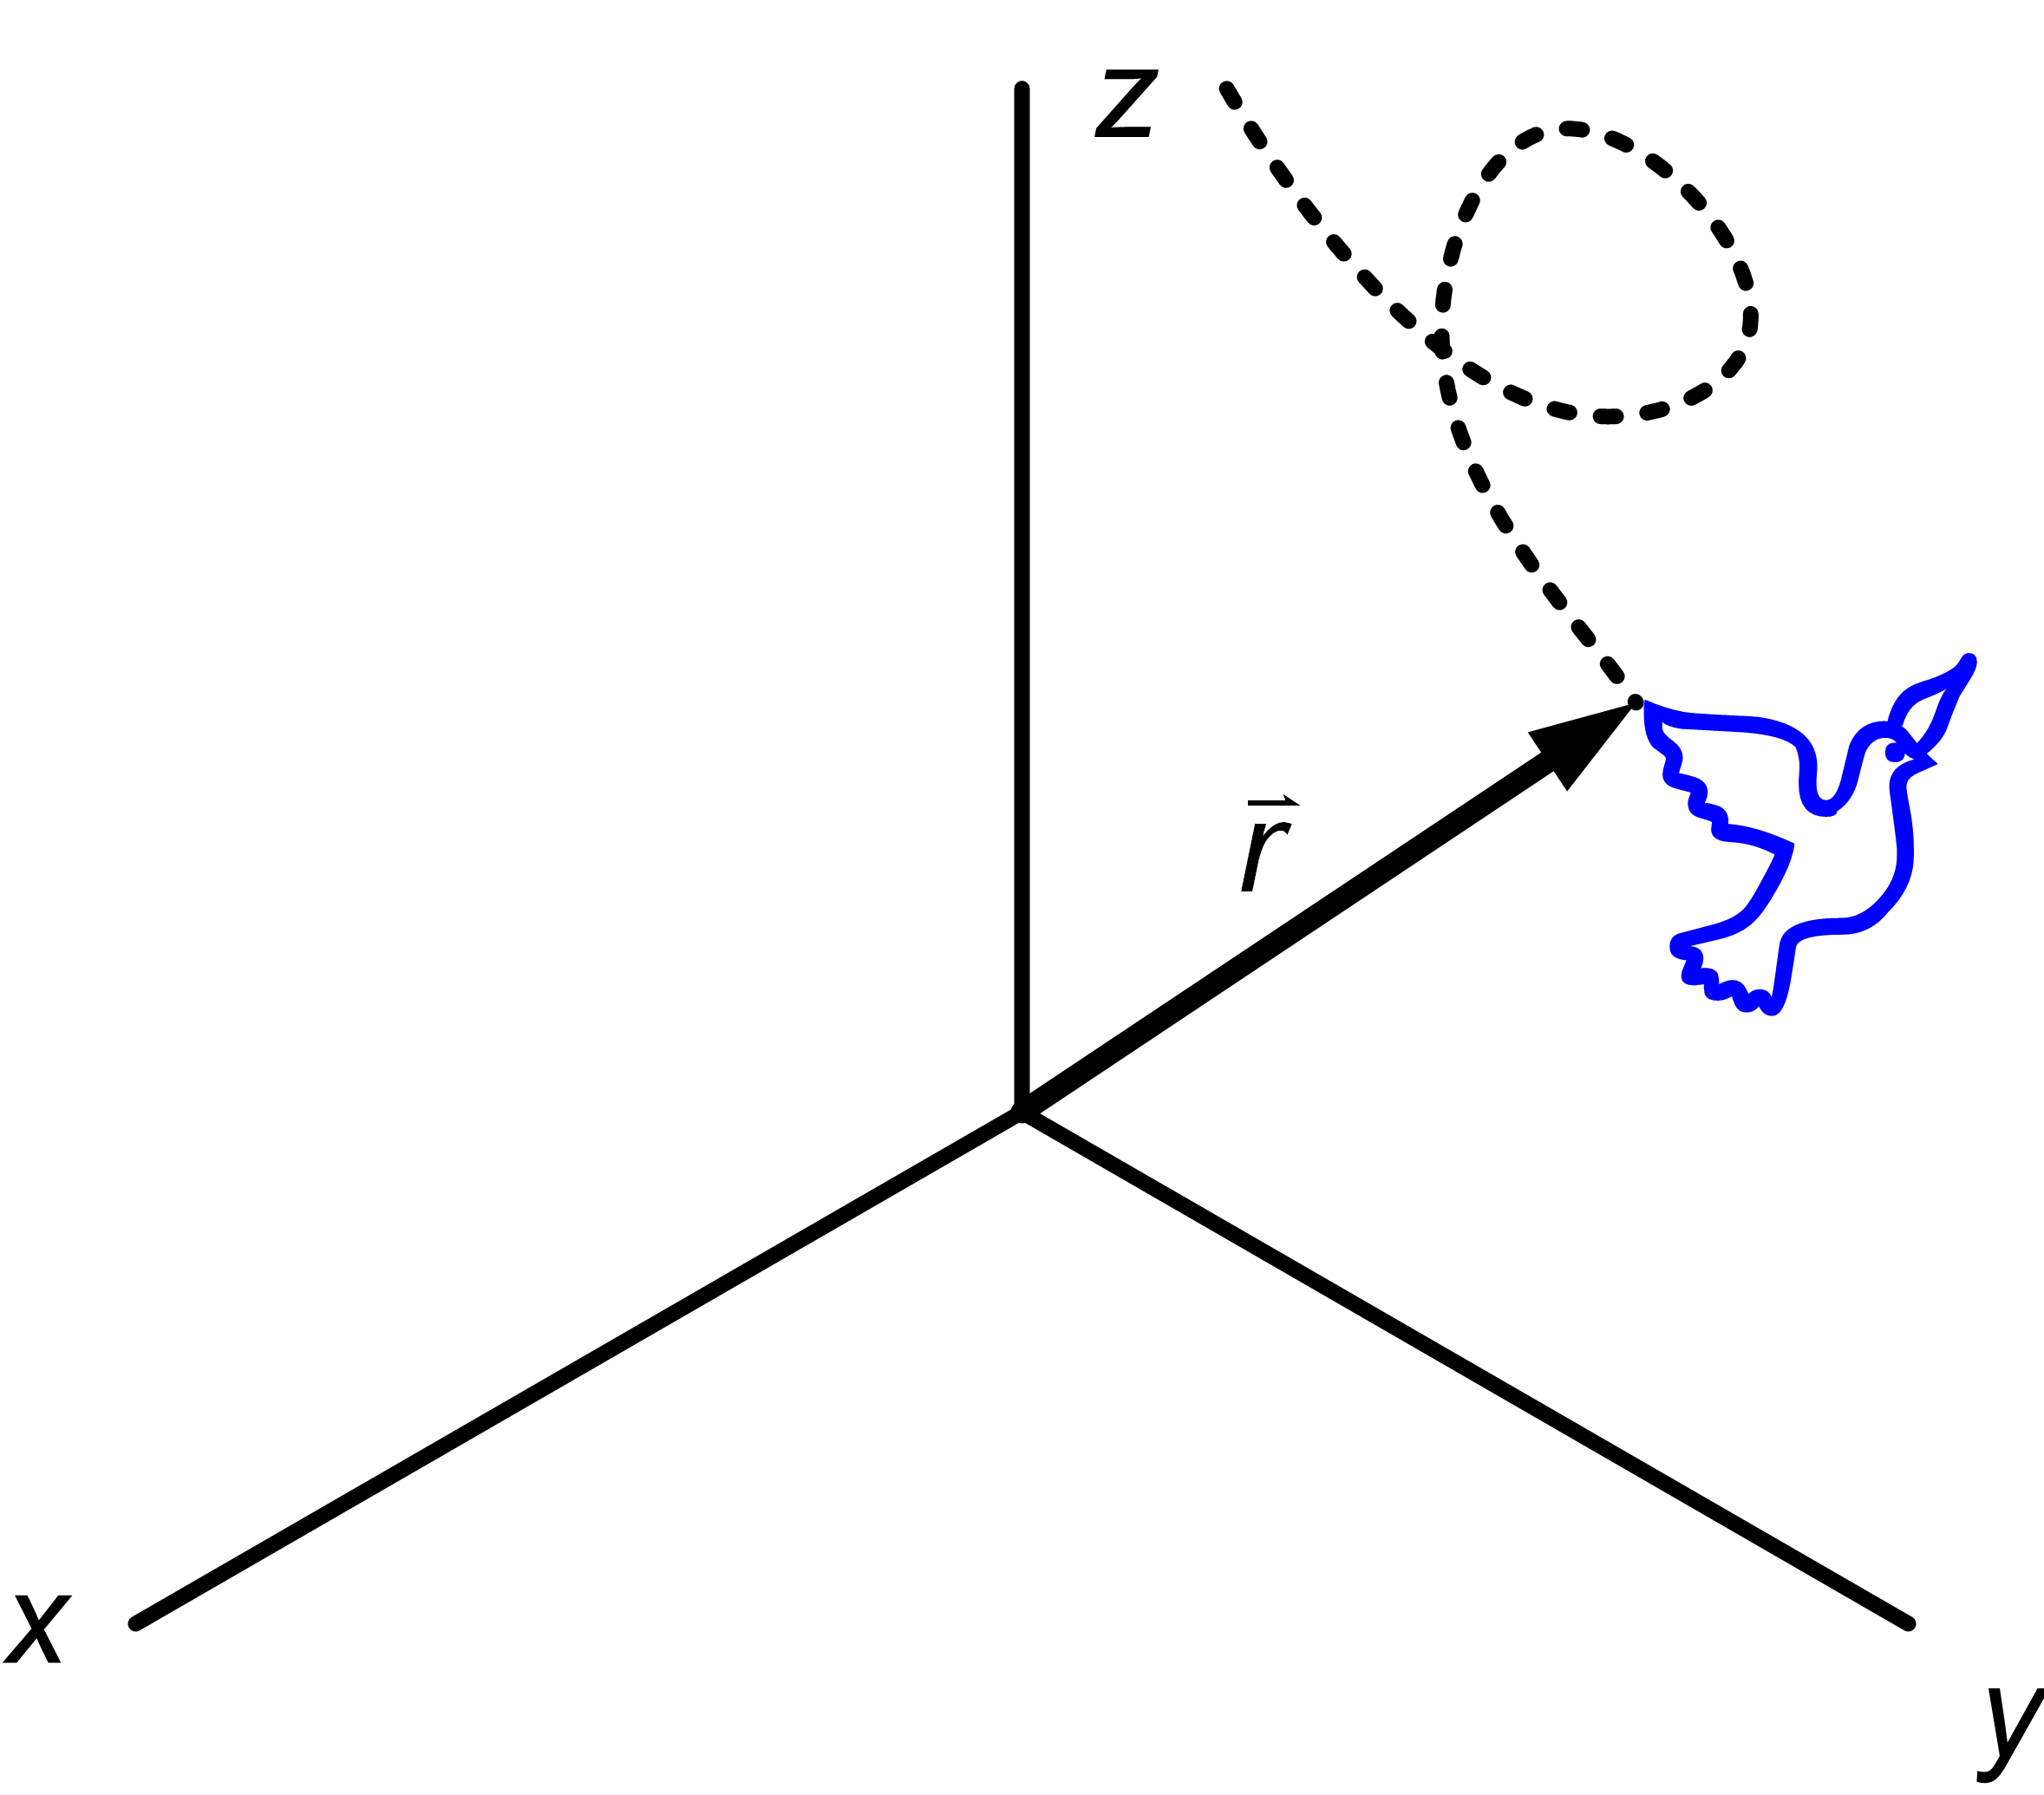
Basic Concept - Definition
position,
velocity,
acceleration
Space: Collection of points whose relative positions
can be described using “a coordinate system”
Time : For relative occurrence of events
Mass : - resistance to change in velocity [Dynamics],
- quantities that influence mutual attraction
  between bodies [Statics]

Slide 7



Basic Concept - Definition
Particle: Body of negligible dimensions
Rigid body: Body with negligible deformations
Non-rigid body: Body which can deform
Before considering whether the body can be assumed rigid-body or not,
you need to estimate the relevant force first.
In Statics, bodies are considered rigid unless stated otherwise.

Slide 8
Basic Concept - Force
Force: Vector quantity that describes an action of
one body on another [Statics]
In dynamics, force is an action that tends to cause acceleration of an object.
The SI unit of force magnitude is the newton (N). One newton is equivalent to one kilogram-meter per second squared (kg·m/s² or kg·m · s ^{– 2})

Slide 9
SCALARS AND VECTORS
Scalars: associated with “Magnitude” alone
- mass, density, volume, time, energy, …
free vector
(“math” vector)
Vectors: associated with “Magnitude” and “Direction”
- force, displacement, velocity, acceleration, …
Magnitude:
Vector :
or V
or V
: Direction

Slide 10
Manipulation
Scalar & Vector
Vector: magnitude & direction, components
  Scalar multiplication
  Addition, subtraction
  Dot product
  Cross product
  Mixed triple product
Mathematical Meanings
vs
Physical Meanings

Slide 11
Vector’s Point of Application
Vectors: “Magnitude”, “Direction”
“Point of Application”
External
effect
The external consequence of these two forces will be the same if ….
Internal
Effect –
stress
?
=
Rigid Body
Fixed Vector
Free Vector
Sliding Vector
E.g.) Force on
non- rigid body
rotating motion, couple
E.g.) Force on
rigid-body
Principle of
Transmissibility
rotation
vector
F
Rigid Body
F
F
point of action
Rotational motion occurs at every point in the object.
line of action

Slide 12
The Principle of Transmissibility
If we concerns only about the external resultant effects on rigid body.
?
=
The two force can be considered equivalent if
……
We can slide the force along its line of action.
(force can be considered as sliding vector)
“A force may be applied at any point on its given line of action without altering the resultant effects external to the rigid body on which it acts.”

Slide 13
Physical Quantity of Vector
Vectors representing physical quantities can be classified
Fixed Vector
  Its action is associated with a unique point of application
  Described by magnitude, direction & pt of application
Sliding Vector
  Has a unique line of action in space but not a unique point of application
  Described by magnitude, direction & line of action
Free Vector
  Its action is not confined or associated with a unique line in space.
  Described by magnitude & direction

Slide 14
PRINCIPLES OF MECHANICS
Some principles that governs the world of Mechanics:
1. The Parallelogram Law
2. The Principle of Transmissibility
3. Newton’s First Law
4. Newton’s Second Law
5. Newton’s Third Law
6. Newton’s Law of Gravitation

Slide 15
THE PARALLELOGRAM LAW
The two vectors V₁ and V₂ ,treated as free vectors, can be
replaced by their equivalent V, which is the diagonal of
the parallelogram formed by V₁ and V₂ as its two sides.
Note: If there are not free vectors, you can sum them if and only if they have the same point of the application.

Slide 16
The Principle of Transmissibility
If we concerns only about the external resultant effects on rigid body.
?
=
The two force can be considered equivalent if
……
We can slide the force along its line of action.
(force can be considered as sliding vector)
“A force may be applied at any point on its given line of action without altering the resultant effects external to the rigid body on which it acts.”

Slide 17
Summation of Force
concurrent forces
non-concurrent
if there are sliding vectors
Free Vector
displacement
S
S

Slide 18
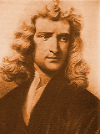
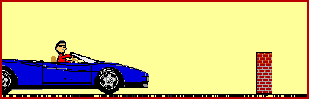
NEWTON’S LAWS OF MOTION (1st Law)
The study of rigid body mechanics is formulated on the basis of Newton’s laws of motion.
First Law:
An object at rest tends to stay at rest and an object in motion tends to stay in motion with the same speed and in the same direction, unless acted upon by an unbalanced force.

Slide 19
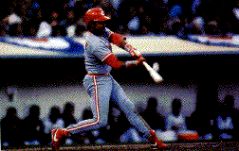

NEWTON’S LAWS OF MOTION (2nd Law)
Second Law:
The acceleration of a particle is proportional to the vector sum of forces acting on it, and is in the direction of this vector sum.
m

Slide 20
NEWTON’S LAWS OF MOTION
Third Law:
The mutual forces of action and reaction between two particles are equal in magnitude, opposite in direction,
and collinear.
Forces always occur in pairs – equal and opposite action-reaction force pairs.
Point: Isolate the body
Confusing?
Concept of FBD (Free Body Diagram)

Slide 21
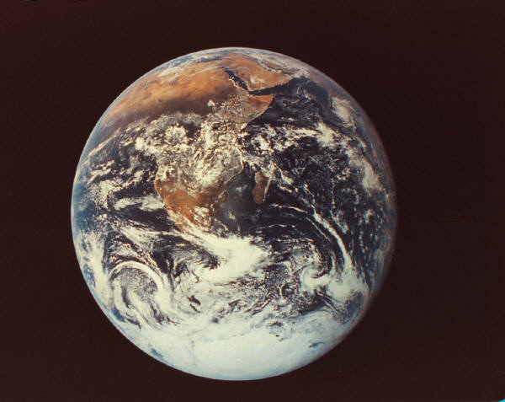
Newton’s Law of Gravitation
M
r
F
m
  - M & m are particle masses
  G is the universal constant of gravitation,
  6.673 x 10⁻¹¹ m³/kg-s²
  - r is the distance between the particles.
For Gravity on earth (at sea level)
m
W=mg
where
- m is the mass of the body in question
- g = GM/R² = 9.81 m/s² (32.2 ft/s²⁾
M

